Slide 1
Transactional Processing
Lecturer: Ngo Huy Bien
Software Engineering Department
Faculty of Information Technology
VNUHCM - University of Science
Ho Chi Minh City, Vietnam
nhbien@fit.hcmus.edu.vn

Slide 2

Objectives
To present how transactional middleware works and when to use it.
To present how transactional middleware and database systems work together to support reliable distributed transaction processing applications.
To learn quickly how to use any transactional middleware product or database system.

Slide 3

Contents
Business Transaction
Transaction Processing
ACID Properties

Slide 4

References
Philip A. Bernstein and Eric Newcomer (2009). Principles of Transaction Processing. Morgan Kaufmann.
Theo Haerder And Andreas Reuter (1983). Principles Of Transaction-Oriented Database Recovery.
Sanjiva Weerawarana et al. (2005). Web Services Platform Architecture. Prentice Hall PTR.

Slide 5
What is Business Transaction? [1]
A business transaction is an interaction in the real world, usually between an enterprise and a person or another enterprise, where something is exchanged.
Transaction processing (TP)—the processing of business transactions by computers connected by computer networks.
An on-line transaction is the execution of a program that performs an administrative function by accessing a shared database, usually on behalf of an on-line user.

Slide 6
Transaction Processing Application
Transaction program is the program whose execution is the transaction.
A transaction processing application is a collection of transaction programs designed to do the functions necessary to automate a given business activity.

Slide 7
Business Process
A business process (workflow) is a set of related tasks that lead to a particular goal.
Example: Process an order for retail goods:
Check the customer’s credit, reserve the required material from stock, schedule the shipment
Give commission credit to the salesperson, submit a request for payment from a credit card company
Perform the shipment, and then validate that the order was delivered.
Business transaction is a business process or a step within a business process.
Business process management is the activity of creating, managing, adapting, and monitoring business processes.

Slide 8
Business Process Definition
A business process definition is an action of specifying the steps of the business process, the work performed by each step, the order in which the steps execute, and how steps communicate with each other.
Finite state machine is a machine having a finite set of states. For each state, it specifies the set of events that can occur. Each event causes the machine to perform an action and move into a different state.
A business process needs to be specified in a formal language. This can be an imperative language with the usual control flow constructs, a finite state machine, or a graphical notation suitable for a visual programming tool.

Slide 9
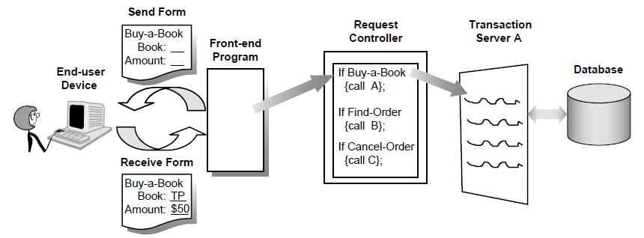
Transaction Processing System
A TP system is the computer system—both hardware and software—that hosts the transaction programs.

Slide 10
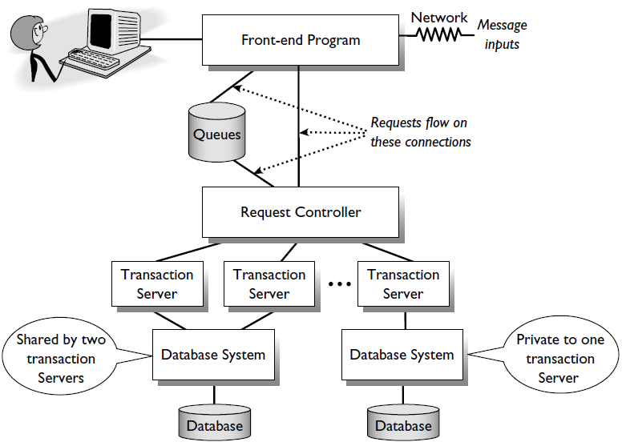
Multi-Tier TP Application Architecture
The request controller processes a request by calling transaction servers, which access databases and other transactional resources.
The front-end program (a web browser) manages the user’s display and outputs requests.

Slide 11


Slide 12
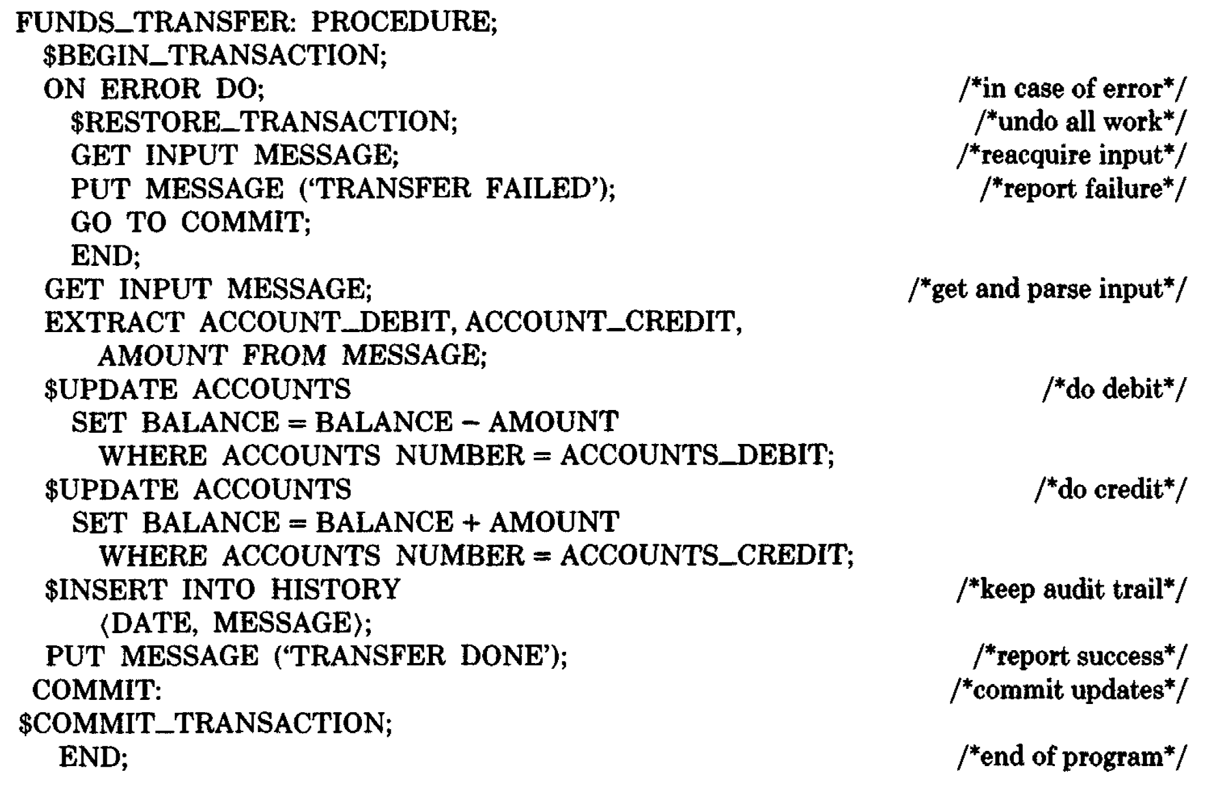
Database Transaction Example [2]
The concept of a transaction, which includes all database interactions between $BEGIN_TRANSACTION and $COMMIT_TRANSACTION in the above example, requires that all of its actions be executed indivisibly:
Either all actions are properly reflected in the database or nothing has happened.

Slide 13

What are ACID Properties?
To achieve this kind of indivisibility, a transaction must have four properties:
Atomicity. It must be of the all-or-nothing type described above, and the user must, whatever happens, know which state he or she is in.
Consistency. Each successful transaction by definition commits only legal results.
Isolation. Events hidden from other transactions running concurrently.
Durability. Once a transaction has been completed and has committed its results to the database, the system must guarantee that these results survive any subsequent malfunctions.

Slide 14
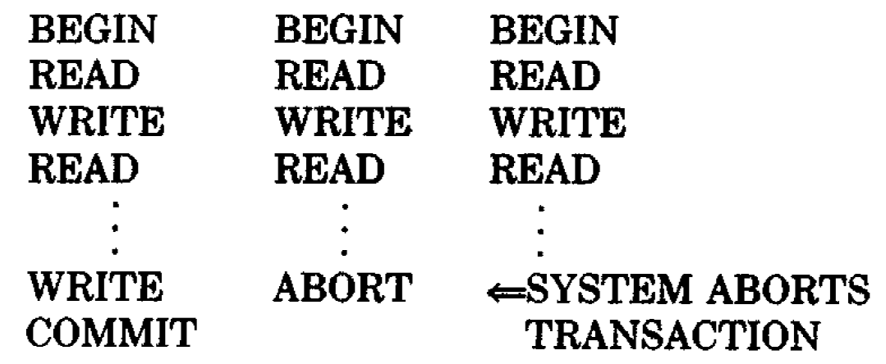
Transaction Termination
A transaction can terminate in the three ways
reaching its commit point or
detecting bad input or other violations of consistency, preventing a normal termination, in which case it will reset all that it has done (abort) or
running into a problem that can only be detected by the system, such as time-out or deadlock, in which case its effects are aborted by the DBMS
or can be affected by a system crash.

Slide 15
Transaction Completion [3]
A transaction can be completed in two ways: committed or aborted (cancelled).
When a transaction is committed, all changes that are caused by operations of the business application are made durable (forced onto stable storage such as a disk).
When a transaction is aborted, all changes that are made during the lifetime of the transaction are undone.

Slide 17
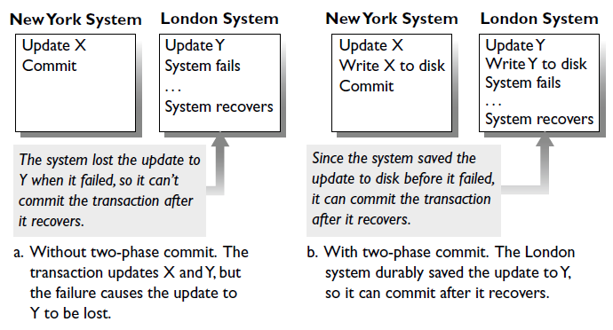
Atomicity Challenge [1]
A transaction can commit its updates on one database system, but a second database system can fail before the transaction commits there too.

Slide 18
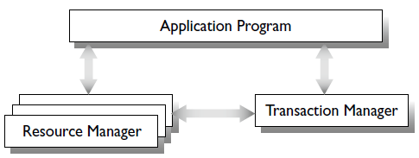
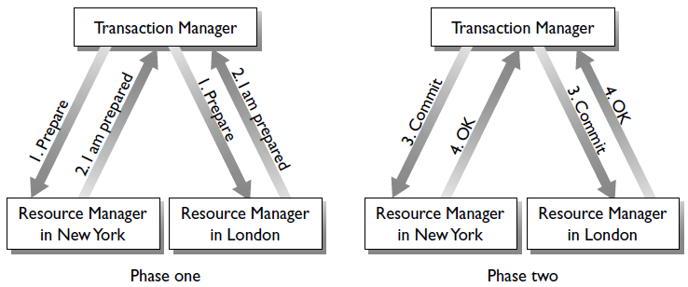
The Two-Phase Commit Protocol

Slide 19
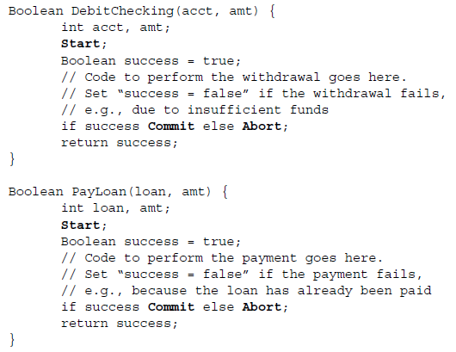
Transaction Bracketing
Transaction bracketing offers the application programmer commands to Start, Commit, and Abort a transaction.
We cannot compose DebitChecking and PayLoan into a larger transaction.
We call this the transaction composability problem.

Slide 20
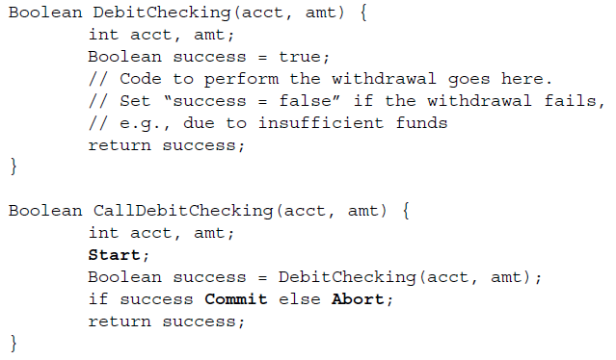
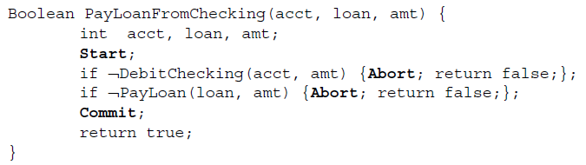
Enabling Composability

Slide 21
Transaction Bracketing in Object-Oriented Programming
Each method is tagged with a transaction attribute that indicates its transactional behavior, thereby avoiding explicit transaction bracketing in the application code itself.
The transaction attribute can have one of the following values:
Requires New: Every invocation of the method starts executing in a new transaction, whether or not the caller is already executing in a transaction.
Required: If the caller is already running within a transaction, then the called method executes within that transaction. If not, then the called method starts executing in a new transaction.
Supported: If the caller is already running within a transaction, then the called method executes within that transaction. If not, then the called method does not execute within a transaction.
Not Supported: The called method does not execute within a transaction, even if the program that created the object is running within a transaction.

Slide 22
Multi-Programmed System
A processor has a state, called the processor context, that consists of a control thread and an address space.
The control thread consists of the values stored in the processor’s registers, such as the instruction counter, the stack pointer, and data registers.
An address space is a mapping of the processor’s view of memory to the physical memory, typically represented in registers that point to page tables.
Every active program has an associated processor state. For a program that’s currently executing, it is the state of the physical processor on which it’s running. For programs that were executing and are temporarily idle, the state is saved in main memory and will be reloaded into a processor when the program resumes execution.

Slide 23
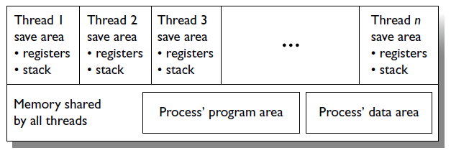
Multithreaded Process
A multithreaded process supports many control threads in a single address space.
Each thread is an independent path of execution through the process.
All the threads in the process execute the same program and use the same process memory. But each of them has a save area for register values and private variables (e.g., the process stack).
A multithreaded process has many executions of its program running concurrently, one for each of its threads.

Slide 24
Remote Procedure Call (RPC)
Remote procedure call (RPC) is a programming mechanism that enables a program in one process to invoke a program in another process using an ordinary procedure call, as if the two programs were executing in the same process (or more precisely, in the same address space).
The RPC runtime system has some extra work to do to allow a transaction to invoke an RPC.
It has to pass the transaction context (transaction ID, security credentials, the identity of the system that started the transaction, and other system information that is required by the callee) from the caller to the callee and must throw transaction-related exceptions back to the caller.

Slide 25
Object-Oriented RPC
In an object-oriented programming model, procedures are defined as methods of classes.
There are two types of methods, class methods and object methods.
A class method is invoked on the class itself, such as the method new, which creates an object (i.e., instance) of the class.
To invoke an object method, the caller uses a reference (i.e., a binding) to the object. This could be created by the caller when it invokes the method new.
If the class is remote, the invocation of new is itself an RPC, which returns a reference to a new object of the remote class. The object lives in the remote class, while the reference is local to the caller.
The reference is thus a local surrogate for the remote object.

Slide 26
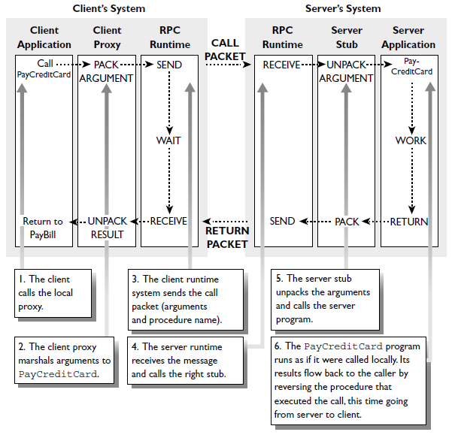
RPC Implementation

Slide 27
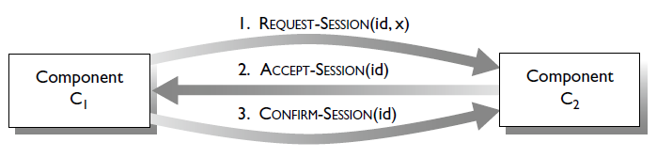
Sessions
A communication session is a lasting connection between two system components, typically two processes, that want to share state.
Three-Way Handshake to Create a Session.
Each component that is involved in a session needs to allocate some memory that holds the shared state associated with the session.

Slide 28
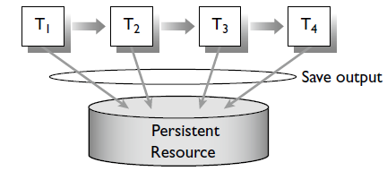
Retaining State in a Business Process
Each transaction in a business process saves the process state for use by the next transaction in the sequence.
A cookie is a small amount of information sent by a server to a web browser that the web browser then stores persistently and returns to the same server on subsequent calls.

Slide 30
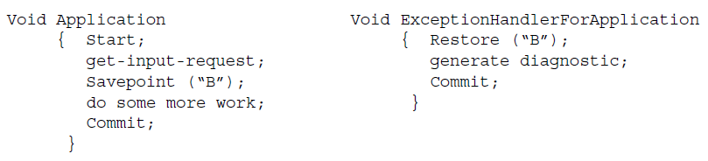
Savepoint
An application program that brackets a transaction must provide error handling for two types of exceptions—transaction failures and system failures.
A savepoint is a point in a program where the application saves all its state, generally by issuing a savepoint command.

Slide 31
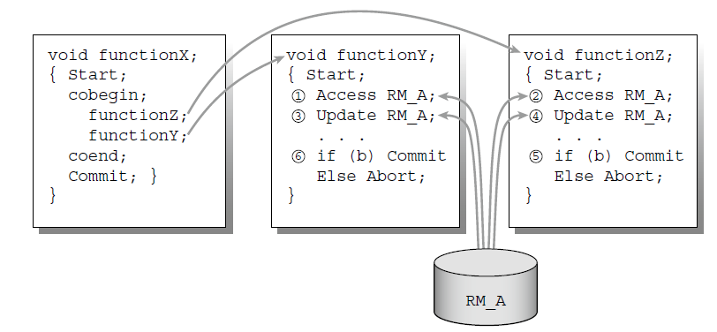
Concurrent Subtransactions
Savepoints aren’t enough for concurrent subtransactions. If functionZ commits and functionY aborts, there is no savepoint in RM_A that produces the right state.

Slide 32
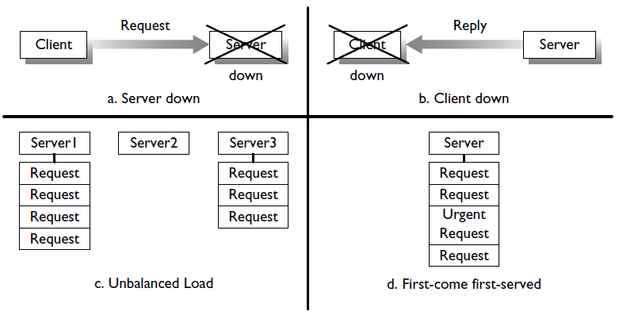
Problems with Direct TP
(a) Sending a request to a down server. (b) Sending a reply to a down client. (c) Balancing the request load across many servers. (d) Scheduling requests.

Slide 33
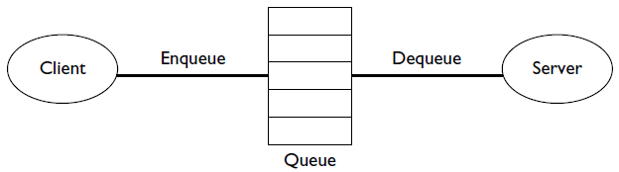
Queued Transaction Model
In queued TP, clients send requests to queues, and servers receive requests from queues. This is in contrast to direct TP, where clients send requests to servers.
To support a queuing model, the system needs a queue manager that stores and manages queues.

Slide 34
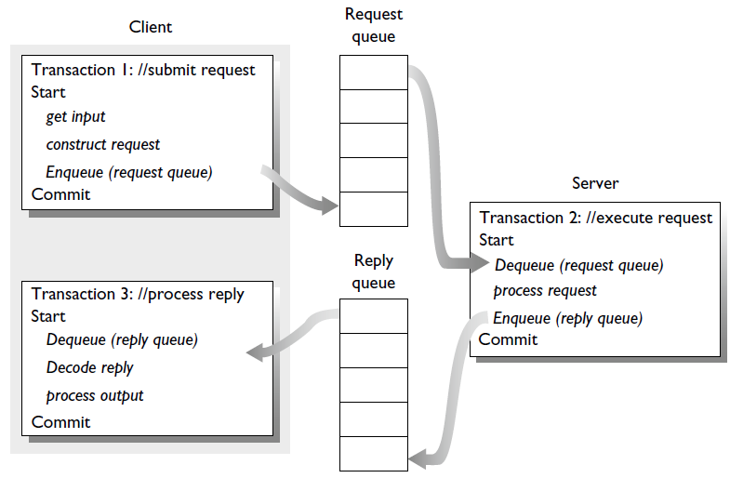
Running a Request as Three Transactions

Slide 35
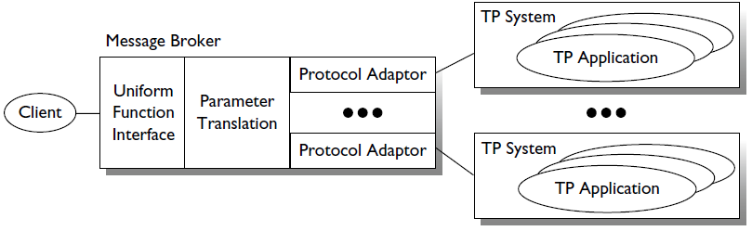
Broker-Based Architecture
Broker-based architecture is a model in which a message server provides a bridge (message broker) between the heterogeneous applications.
A client communicates with the broker, which forwards the message to the desired application.

Slide 36
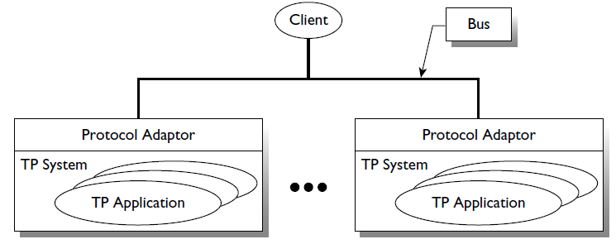
Bus-Based Architecture
Bus-based architecture is a model in which the client talks directly to TP applications using a standard wire protocol.
If a TP system does not support the common protocol, then it needs to have a protocol translator that translates from the bus’s common protocol to the system-specific technology for calling the TP system’s applications.

Slide 38
Serializable Execution
Serializable execution is an execution that has the same effect as a serial execution, i.e. running the transactions serially, one after another, in sequence, with no overlap in executing any two of them.

Slide 39
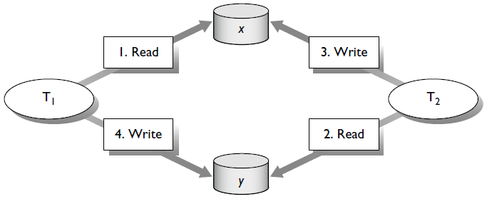
A Nonserializable Execution
x = 10, y = 10
T₁ reads x and later writes y (++y), and T₂ reads y and later writes x (++x).
T₁T₂ = r₁[x] w₁[y] r₂[y] w₂[x]. T₁: x = 10, y = 11. T₂: x = 11, y = 11
T₂T₁ = r₂[y] w₂[x] r₁[x] w₁[y]. T₂: y = 10, x = 11. T₁: x = 11, y = 11
E = r₁[x] r₂[y] w₂[x] w₁[y] is a nonserializable execution because
T₁: x = 10. T₂: y = 10. T₂: x = 11, T₁: y = 11 i.e.
T₁: x = 10, y = 11. T₂: x = 11, y = 10 does not match with T₁T₂ or T₂T₁.

Slide 40
Locking
The most popular mechanism used to attain serializability is locking.
Each transaction reserves access to the data it uses. This reservation is called a lock.
There are read locks and write locks.
Before reading a piece of data, a transaction sets a read lock.
Before writing the data, it sets a write lock.
Read locks conflict with write locks, and write locks conflict with both read and write locks.

Slide 41
Two-Phase Locking Theorem
Two-phase locking is a lock mechanism in which a transaction obtains all its locks before releasing any of them.
Two-Phase Locking Theorem: If all transactions in an execution are two-phase locked, then the execution is serializable.

Slide 42
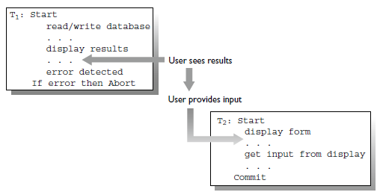
Transaction Handshakes
Transaction handshake is a situation when a user wait until a transaction has committed before using that transaction’s output as input to another transaction
Transaction Handshake Theorem: For every two-phase locked execution, there is an equivalent serial execution that preserves all transaction handshakes.

Slide 43
Lock Managers
A lock manager is a component that services the operations:
Lock (transaction-id, data-item, lock-mode): Set a lock with mode lock-mode on behalf of transaction transaction-id on data-item.
Unlock (transaction-id, data-item): Release transaction transaction-id’s lock on data-item.
Unlock (transaction-id): Release all transaction transaction-id’s locks.
The size of data items that the data manager locks is called the locking granularity.
The data manager could lock at a coarse granularity such as files, at a fine granularity such as records or fields, or at an intermediate granularity such as pages.

Slide 45
Transactional Middleware Products
Transactional middleware products provide a configurable deployment container for application objects.
The goal of the container is to reduce complexity by packaging together system capabilities such as transaction control, threading, and persistence, and enabling a developer to customize them using configuration properties.
Container-managed transactions (implicit programming model) is a model that allows an application developer to create TP programs that incorporate the business logic without describing transactional behavior (which parts of the code need to run as transactions). Transactional behavior is defined in another step using configuration properties.

Slide 46
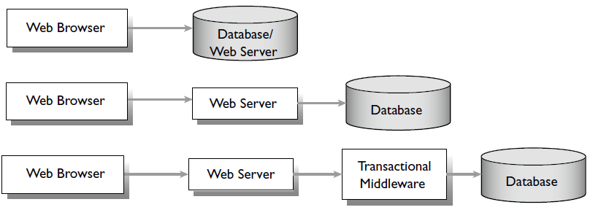
Web Browsers and Multitier TP Architecture
A web browser requires a web server to handle HTTP requests and replies.
In the multitier architecture the web server may directly interact with the database or with one or more intermediate tiers created using transactional middleware components.

Slide 47
.NET Framework Components
Windows Presentation Foundation (WPF), ASP.NET, and Silverlight for developing PC-based or browser-based front-end programs.
Windows Communication Foundation (WCF) and the Internet Information Server (IIS) for developing and deploying request controllers and transaction servers.
Host Integration Server (HIS) and BizTalk Server adapters for integration with legacy environments.
Windows Workflow Foundation (WF) and WS-BPEL support in BizTalk Server for creating and executing business processes, including those that combine multiple services.

Slide 48
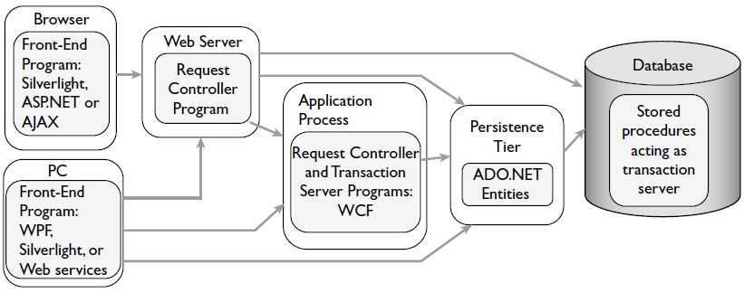


.NET Framework Multitier Transactional Middleware Architecture

Slide 49
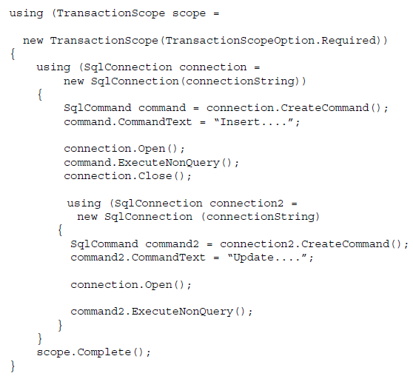
.NET Explicit Transaction Control

Slide 50
.NET Transaction Management
The Microsoft Distributed Transaction Coordinator (DTC) that use multiple resource managers (RMs) is the general-purpose transaction manager for transactions.
DTC supports any XA-compliant RM, such as Oracle Database and IBM’s DB2, and can include them within a DTC managed transaction.
The Lightweight Transaction Manager (LTM) can handle any number of volatile resources and at most one persistent resource. LTM is cheaper than DTC because it doesn’t require a log.

Slide 51
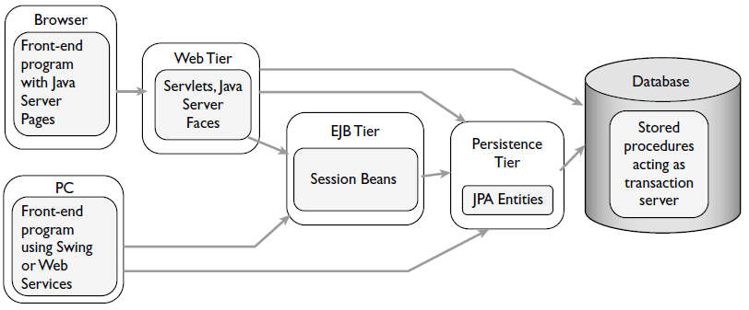
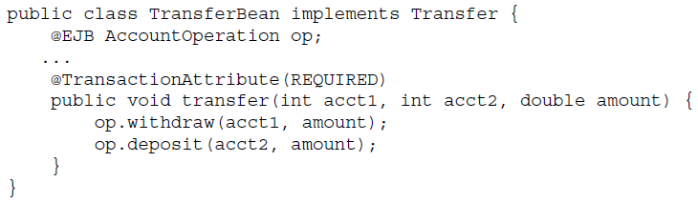
Java EE Multitier Transactional Middleware Architecture

Slide 52
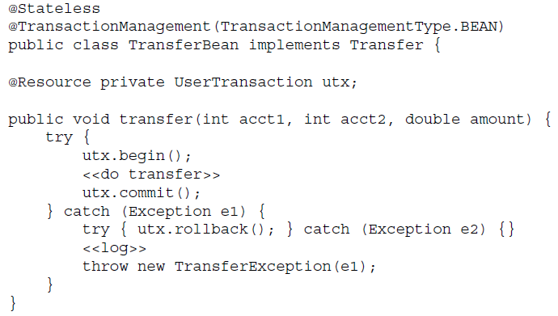
Java Explicit Transaction Control

Slide 53

Thank You & See You Again

